Slide 1
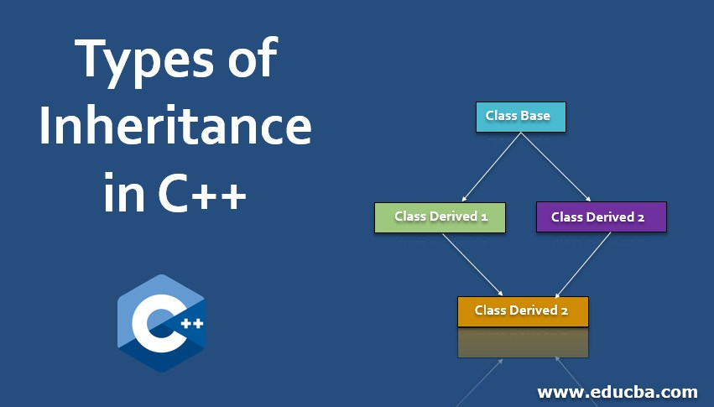

Slide 2
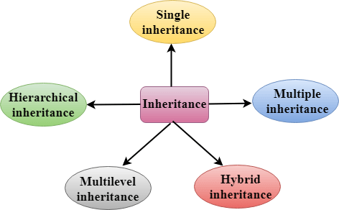
INHERITANCE IN C++
The capability of a class to derive properties and characteristics from another class is called Inheritance. Inheritance is one of the most important features of Object-Oriented Programming.
Inheritance is a feature or a process in which, new classes are created from the existing classes. The new class created is called “derived class” or “child class” and the existing class is known as the “base class” or “parent class”. The derived class now is said to be inherited from the base class.

Slide 3
Modes of Inheritance
There are 3 modes of inheritance.
Public Mode: If we derive a subclass from a public base class. Then the public member of the base class will become public in the derived class and protected members of the base class will become protected in the derived class.
Protected Mode: If we derive a subclass from a Protected base class. Then both public members and protected members of the base class will become protected in the derived class.
Private Mode: If we derive a subclass from a Private base class. Then both public members and protected members of the base class will become Private in the derived class.

Slide 4


